Slide 1
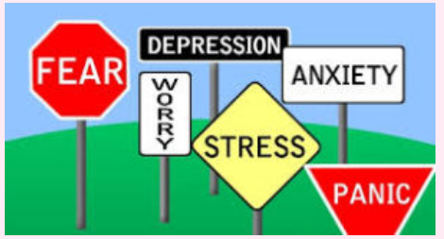
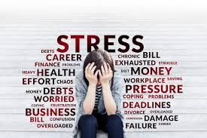
Conversation class
Christopher bAUMAN

Slide 2
Education Infographic
1. Accept that you cannot control everything in your life.
When you accept that some things are out of your control, including the people around you and the decisions they choose to make, you can start putting your stress into perspective. Try acknowledging that something is out of your control and release it, you can do this by writing it down or in your mind.
2. Do your best
Aiming for perfection can be extremely stressful, as we are humans and innately imperfect. Take a step back and acknowledge that you’ve done the best you could in the situation or project.
3. Try to keep a positive outlook
When you are deep in anxiety or stress, it can be hard to see the positive aspects of a situation, however when you take moment to think of the things you are doing well, no matter how small, it can make a big difference. Offering gratitude to a situation or something in your life can help ease your mind.
4. Learn what triggers your stress or anxiety
Is it a particular person, job, school or something else you can identify that is the source of your anxiety or stress? You can identify a pattern by journaling or writing down the situation when you feel this way.
Teachers
Education
Skills
Chris Bauman

Slide 3
5. Limit alcohol and caffeine
Alcohol and caffeine can aggravate anxiety and trigger panic attacks, even if it “helps” in the short term. Drink water instead.
6. Eat well-balanced meals
While you may not feel like eating in the midst of anxiety and stress, it is important to keep eating, even if they are very small meals. Eating healthy, energy-boosting snacks, such as nuts or herbal tea can help keep your body in good health to avoid illness.
7. Get enough sleep
When you are stressed, your body needs additional sleep and rest. It can be hard to get to sleep and stay asleep when your mind is racing. Try and utilize practices such as journaling to get your thoughts on paper or simple meditation to help with breathing into sleep.
8. Move your body daily
Moving your body is so important when you are feeling stressed or anxious. The word “exercise” can be overwhelming, so think of it as whatever you do to move your body. This could be taking a walk on your lunch break or after dinner, dancing to your favorite song or doing simple yoga to stretch your body.

Slide 4
9. Take deep breaths
Taking deep, slow breaths can significantly help when you are feeling stressed. Use this exercise below:
10. Give back to the community
Volunteering and performing acts of kindness increases your mental wellness. It can also create community and gives you a break from everyday stress.
11. Take time off
Sometimes the only way to reduce stress and anxiety is to take time for yourself. Doing yoga, listening to music or taking a mental health day can help you step back from your situation and analyze it with a clearer mind.
12. Get help
Whether you get help online, reach out to a friend or family member, or find a therapist, it is helpful to talk to someone about what you are feeling. There is nothing to be ashamed of for feeling overwhelmed or anxious. Therapy is a great way to receive objective and non-judgmental help.

